Slide 1
Accure Autoencoder for Denoising OCR
Summer 2020 – Section 002

Slide 2
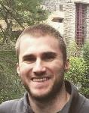
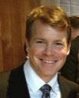
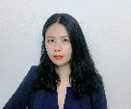
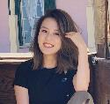

TEAM AUTOENCODERS - MEMBERS
Matt Machado
Product Owner
Stephen Schade
SCRUM Master
Yun Li
Developer
Jun Wang
Developer
Gauthami Kuravi
Developer

Slide 3



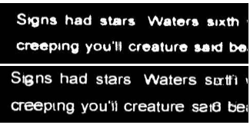



TEAM AUTOENCODERS – PROBLEM CONTEXT & STATEMENT
Problem Context:
Domain of problem: OCR technology is valuable in any instance where documents or images have text, such as healthcare, banking, manufacturing, legal, business, and other industries associated with heave paperwork or documentation
Importance of problem: Image “noise” is one reason that OCR technology may have trouble reading character text. Removing noise makes OCR more reliable.
Problem Statement:
It is difficult to translate text images into text data without some inaccuracies or errors. This project will build a Convolutional Neural Network (CNN) auto-encoder that attempts to reduce image noise during OCR processing. We will evaluate the fidelity of our CNN by conducting OCR text extraction on a dataset before and after the implementation of our method.
Example: Before (top) and after (bottom) OCR denoising

Slide 4
Team Autoencoders – Risks and Mitigations

Slide 5
TEAM AUTOENCODERS – KEY RESULTS
Key Results:
Constructed 8 CNN-autoencoder model variants with distinct tuning parameters.
Trained and assessed 3 CNN-autoencoder model variants with most potential.
Observed an English-language word recognition improvement of as many as 4 words when compared to the original image’s OCR performance.
Identified future opportunities for greater model improvement

Slide 6
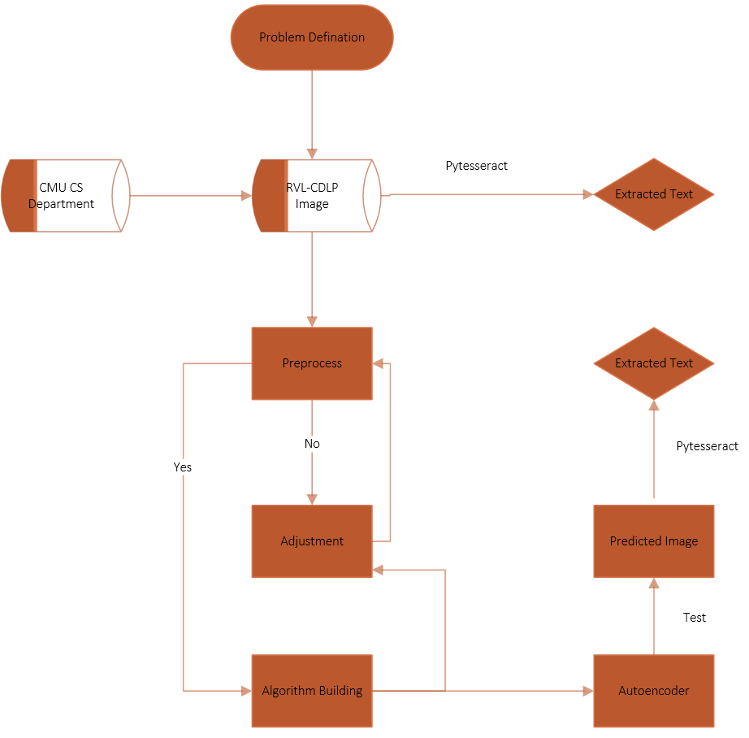
TEAM AUTOENCODERS – SYSTEM ARCHITECTURE

Slide 7
AUTOENCODERS – DATASETS
Datasets Planned for Project
Dataset Name: Ryerson Vision Lab Complex Document Information Processing (RVL-CDIP):
Dataset Owner: Adam W. Harley, Alex Ufkes, and Konstantinos G. Derpanis, stored by Carnegie Mellon’s computer science department.
Dataset Type: Open source, academic computer vision project database
Dataset Size: 37GB
Dataset License: The authors ask that users cite their paper if using this dataset.
A. W. Harley, A. Ufkes, K. G. Derpanis, "Evaluation of Deep Convolutional Nets for Document Image Classification and Retrieval," in ICDAR, 2015
Dataset Location: Web-accessible
Dataset Access: Publicly available.
Dataset Restrictions: None.
Analytic/Algorithm that will use dataset: tesseract optical character recognition; convolutional neural network.
Storage: Google Drive
Format: TIF (Tagged Image File) PNG

Slide 8
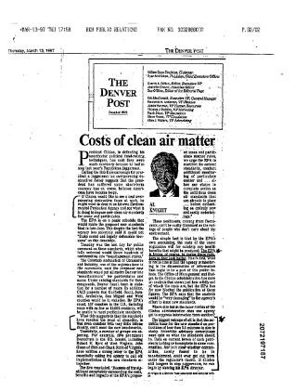
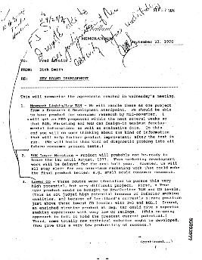
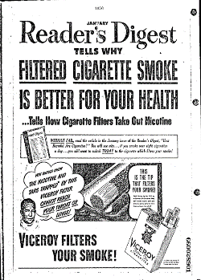
AUTOENCODERS – DATASET EXAMPLE
News
Memo
Ads

Slide 9
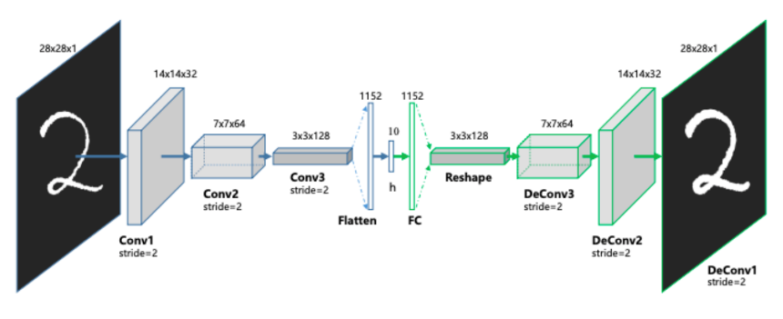
TEAM AUTOENCODERS – ANALYTICS/ALGORITHMS STRUCTURE
Autoencoder : Encoder & Decoder
Source:
https://towardsdatascience.com/convolutional-autoencoders-for-image-noise-reduction-32fce9fc1763

Slide 10
TEAM AUTOENCODERS – ANALYTIC/ALGORITHM SPECIFICATION
Name: Convolutional Autoencoder
How it works: Unsupervised machine learning algorithm that takes an image as input and tries to reconstruct it back using a fewer number of bits from the latent space representation.
Encoder: Conv2D and Max pooling Layers.
Decoder:Conv2D Transpose and Upsampling 2D layers
Libraries : Numpy, Tensorflow, Keras, OpenCV, Pytesseract
Data Inputs: Image data in .Tiff format are converted to PNG
Parameters: Learned neuron weights and bias
Hyperparameters: Width, Height, Filter size&numbers, Latent Dimension, Stride
Model Tuning: Input Size, No. of Layers, Loss function, Activation function, Iterations
Model Training Resources Required: GoogleColab, Local computer + GPU, AWS
Model Deployment: Trained model is used to improve the text quality extracted from the image.

Slide 11
TEAM AUTOENCODERS – PERFORMANCE INDICATORS
TEAM AUTOENCODERS – ANALYTICS/ALGORITHMS MEASUREMENTS
Evaluate the overall improvement through 3 measurements:
Original Image
VS
Processed Image
Text Result
(Before Autoencoder)
VS
Text Result
(After Autoencoder)
Loss
(start)
VS
Loss
(finish)

Slide 12

TEAM AUTOENCODERS - PARAMETERS
PARAMETER | ad200 | ad3.5k | ad10k
training iterations | 200 | 3500 | 10000
Encode Convolutional Layers | 3 | 4 | 4
Encode Pooling Layers | 3 | 4 | 4
Decode Convolutional Layers | 4 | 5 | 5
Decode Upsampling Layers | 3 | 4 | 4
Dense Layers | 1 | 1 | 1
Latend Dimensions | 196 | 512 | 196
Image size | 216x216x3 | 1000x504x3 | 1000x504x3
training images | 19000 | 2000 | 2000
validation images | 2500 | 600 | 600
loss function | sparse categorical cross entropy | mean squared error | mean squared error
activation function | ReLU | ReLU | ReLU
optimizer | adadelta | adadelta | adadelta
Visual Performance Indicator | Blurry | Clear (larger font) | Clear (larger font)
Loss Performance Indicator | Start:18 / end:0.1 | Start:0.09 / end:0.0114 | Start:0.09 / end:0.0109
Max char recognition over original | -null | +2 words | +4 words
Minimal loss optimization between 3,500 and 10,000 training iterations
The time and cost of optimization: Expensive!

Slide 13
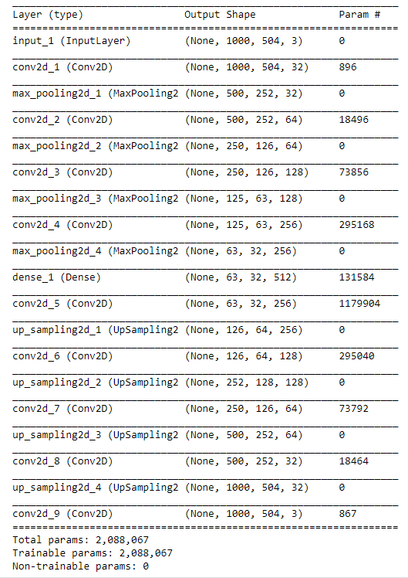
TEAM AUTOENCODERS - PARAMETERS
ad3.5k, ad10k
2 million+ parameters
Unable to train locally
160+ training hours

Slide 14
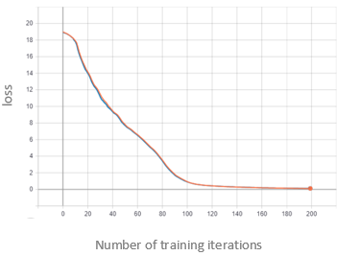
TEAM AUTOENCODERS – LOSS CHART
Training loss – ad200 model

Slide 15
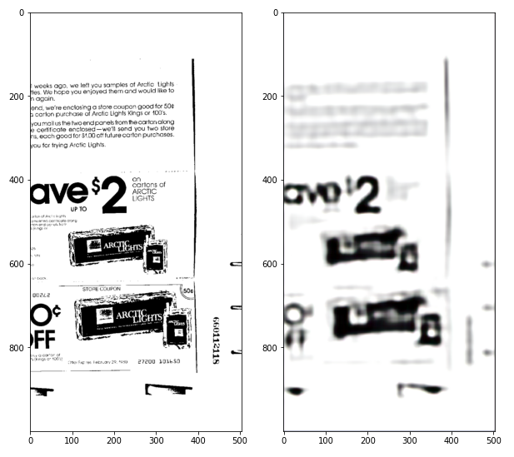
TEAM AUTOENCODERS – STARTING POINT
*10 epochs(in progress…)

Slide 16
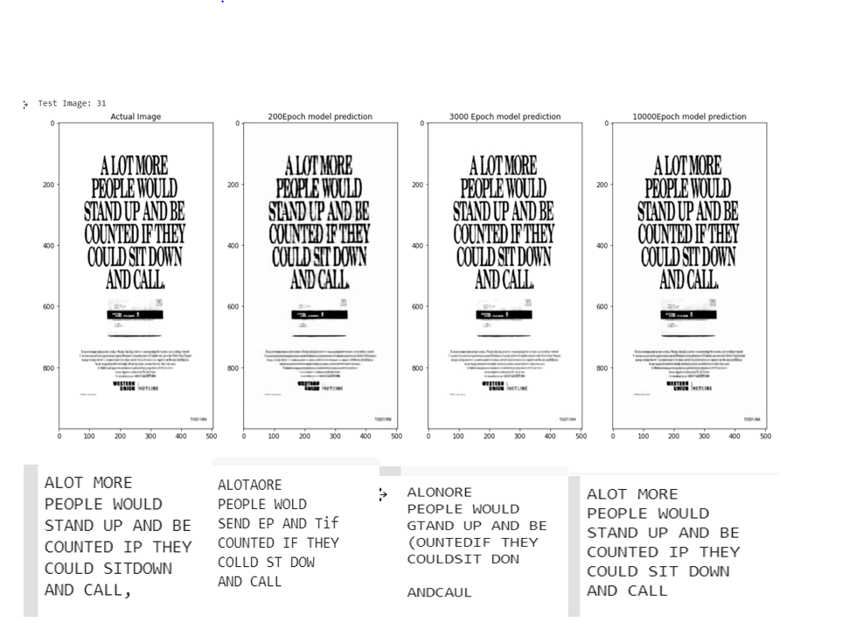
TEAM AUTOENCODERS – FINDINGS

Slide 17
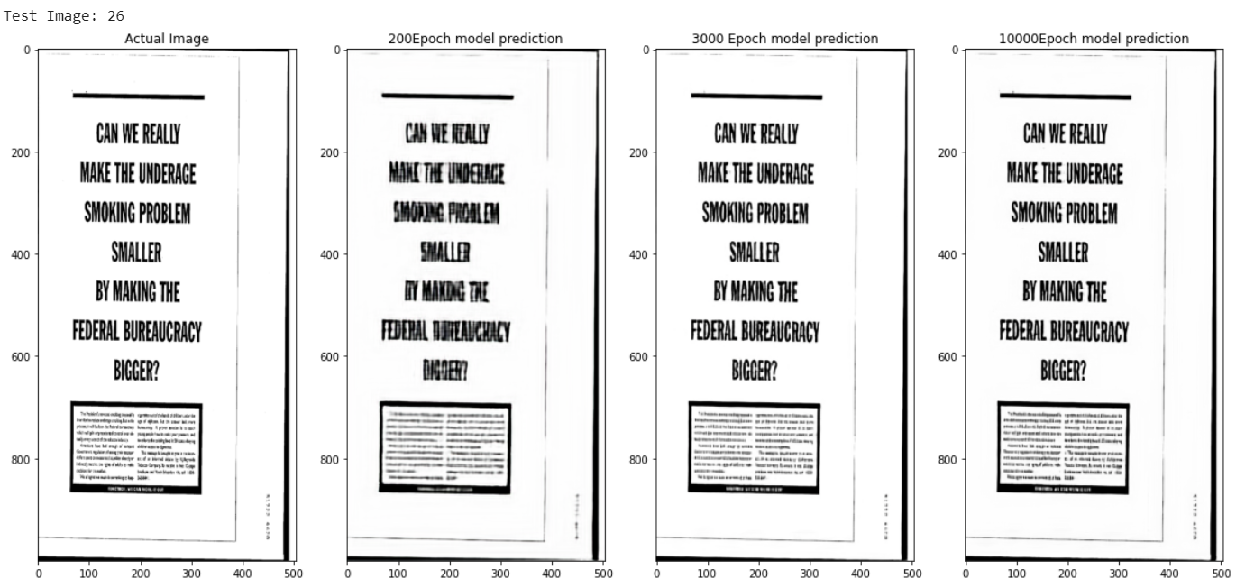
TEAM AUTOENCODERS - FINDINGS
13 Words
0 Words
14 Words
15 Words

Slide 18
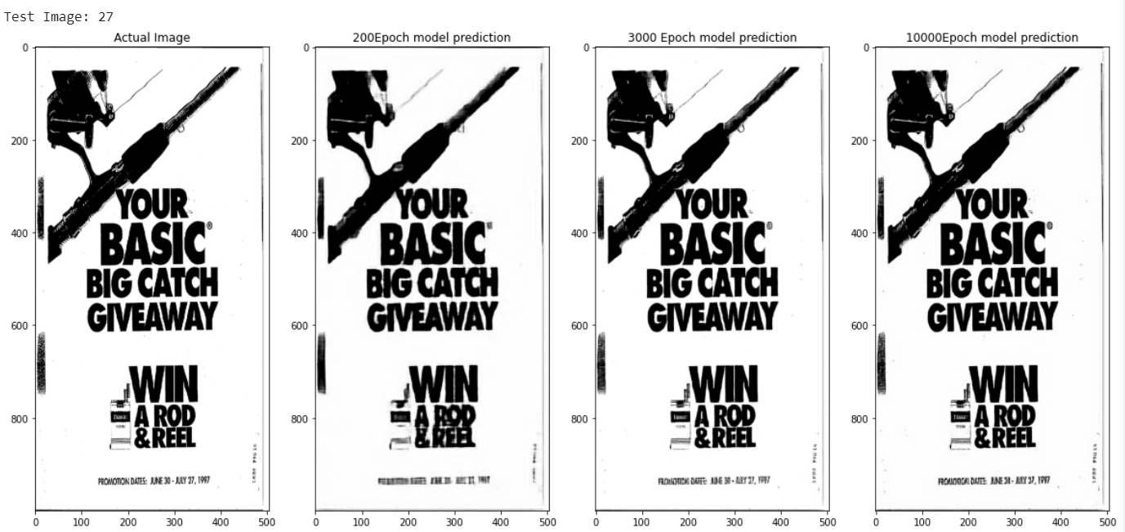
TEAM AUTOENCODERS - FINDINGS
5 Words
0 Words
9 Words
9 Words

Slide 19
TEAM AUTOENCODERS – FUTURE WORK/LESSONS LEARNED
Future Work
Improve autoencoder results by splitting images into smaller subsection
Continued parameter tuning
Filter size, latent space, number of training images, number of layers, etc.
Try different document types
Lessons Learned
Experimentation on smaller pieces of data is critical to breaking bottlenecks
Autoencoders are hard
Lack of relevant examples(i.e. MNIST)
Lack of available solutions to errors
Long training times even with AWS resources

Slide 20
ACKNOWLEDGEMENTS
Shamshad Ansari, President & CEO at Accure
(Project Sponsor)
Professor Rajesh Aggarwal
Professor James Baldo
Amazon Web Services(AWS)

Slide 21
Any Questions？

